Slide 1
Two Old Women:
An Alaska Legend of Betrayal, Courage and Survival
Notes:
Let’s think about the “binary construction” of the terms, “Betrayal/Trust,” “Courage/Fear” and “Survival/Hopelessness”

Slide 2
"…it seems possible to read Two Old Women as a kind of metaphor for Wallis’ own childhood and role as a once emerging—but now accomplished—writer.”

Slide 3
A Beginning….
“[Her] personal odyssey began in Fort Yukon, Alaska, a location accessible only by riverboat, airplane, snowmobile or dogsled.”
“Having dropped out of school at the age of 13 in order to care for her siblings in the wake of their father’s death, Wallis passed her high school equivalency test—earning her GED—and then surprised friends and relatives by choosing to move into an old trapping cabin twelve miles from Fort Yukon” (now defunct website).

Slide 4
Legendary tale of survival and courage…
Two Old Women has sold 1.5 million copies and has been translated into 17 languages worldwide.
"…a group of University of Alaska students taught by Lael Morgan—co-founder of Epicenter Press along with Kent Sturgis—started a grass roots effort intended to raise enough money to publish the manuscript.
Since that time, Wallis has written two additional books—Bird Girl and the Man Who Followed the Sun and also Raising Ourselves” (now defunct website).

Slide 5
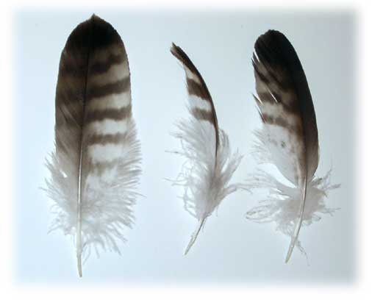
Human Themes within the text…
Problems of aging
Role/Value of Elders
Survival in nature
Ingenuity
Commitment to relatives and community
Obligation

Slide 6
More themes to consider…
Resilience,
Hope,
The age-old conflict between the rights of the individual and the common good
Conflict and cooperation
The power of reconciliation to heal individuals and communities.

Slide 7
Close Reading is Required!
In this course, we will be using the “Close Reading Interpretive Tool” referenced as CRIT.
It is a systematic approach to literary analysis that has 6 steps:
Paraphrase
Observe
Contextualize
Analyze
Argue
Reflect

Slide 8
PARAPHRASE…Step number one!
Consider factual context only.
What situation is begin described by whom?
What are the words indicating and how is the author leading me through the story?
This is accomplished on the “first read” of a sentence, paragraph or a page. Just listen to the narrative and record what you understand is happening in your own words.

Slide 9
Observe….Step number two!
Pay close attention to language and form. What words did the author choose? (diction, a literary device)
What form is the author using to tell the story? Is it being accomplished through the dialogue of the characters? Is there an extensive use of imagery? Metaphor? Simile? Repetition?
Pay close attention to the length of the sentences. Are long flowing sentences lulling the reader into a dreamlike state? Or is the author using short sentences to convey a harsh point from which the reader has no escape? For example, “She cried out in pain.”

Slide 10
Contextualize…step number three!
What is the historical period of the narrative?
Contemporary?
Ancient?
What is the geographical location?
What is the cultural location?
What is happening during this time period, events or other happenings that impact the telling of the story?
What are the circumstances of the characters? What kinds of societal norms trap them or dictate their thoughts and actions?
How do they abide by their belief systems or other directives?

Slide 11
Analyze….Step number four!
How does your paraphrase, observation, and context inform your impressions of the deeper meaning or interpretation of the text?
Review steps one through three and figure out connections and how they relate to each other to create an understandable whole or a message.

Slide 12
ARGUE….Step number five!
What perspective do you think is valid? What message or overall theme do you think stands out in the narrative.
For example, “Working for the good of the collective (or the whole) is better than working for the good of the individual.”
What is your point of view regarding the narrative? What messages are being communicated? What do you believe the text is expressing? Why is that important?

Slide 13
REFLECT….Step number six!
Think about all of your assumptions and interpretations. Are they reasonable?
Will others see your evidence and your conclusions as reasonable?
What stood out to you? What did you discover after reading a section, a chapter or the entire story?
Can you give an example that will help others relate to your point of view or your conclusions about the text?

Slide 14
The Final Thought…
The purpose of reading Ethnic Literature is to listen to the voices of writers who have been silenced politically and socially for many generations and for many reasons.
Our goal is to listen for their messages, their symbolic sharing, and to find connections to our own lives. Although the stories take place in various geographical locations---many times unfamiliar to us, their humanity is visible---
We all share the human themes of fear, love, hope, betrayal, connection, loss, peace, arrogance, beauty, power, evil, persistence, death, survival, courage…..

