Slide 1
Chapter 3 Intro
Misuses of Statistics

Slide 2
Suspect Samples: Size
Very small sample size:
Three out of four doctors surveyed recommend brand X.
If only 4 doctors were surveyed, the results could have been obtained by chance alone.

Slide 3
Suspect Samples: Size
Larger sample is better!
If 100 doctors were surveyed,
the results might be quite different.

Slide 4
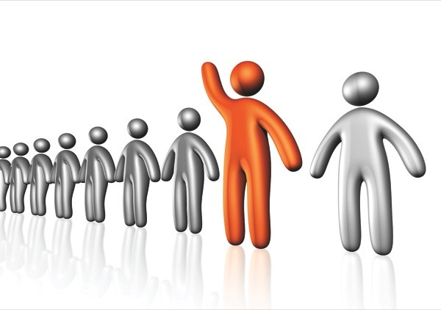
Suspect Samples: Selection Method
Volunteer sample:
Volunteers generally do not represent the population at large.
Recruited from a particular socioeconomic background
Sometimes unemployed volunteer for stipend
Studies involving weekday participation, exclude the employed

Slide 5
Suspect Samples: Selection Method
Convenience sample:
In the past, many studies have used only men,
but have attempted to generalize the results
to both men and women.

Slide 6
Suspect Samples: Selection Method
Convenience sample:
Educational studies sometimes use students in intact classrooms since it is convenient.
Quite often, the students in these classrooms do not represent the student population of the entire school district.

Slide 7
Ambiguous Averages
Measures of average include mean, median, mode, and midrange.
}
Data Set
1
1
1
2
28
56
103
Measures of Average
Mean = 27.4
Median = 2
Mode = 1
Midrange = 51
These averages are very different and can be
misleading.
The average can be chosen to provide the most evidence to support a particular position.

Slide 8
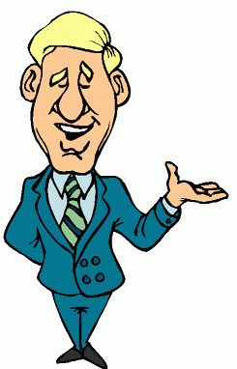
Changing the Subject
The same data represented different ways.
During my opponent’s administration expenditures have increased a whopping $6,000,000
During my administration expenditures increased a mere 3%
Both statements are correct. Depends on what you want to say!

Slide 9
Detached Statistics
A claim that used a detached statistic is one in which no comparison is made.
This cereal has
fewer calories!
Fewer calories than what?

Slide 10
Implied Connections
Many claims attempt to imply connections between variables that may not actually exist.
?
Eating fish may help to reduce your cholesterol

Slide 11
Misleading Graphs
A graph is a visual representation of data that enables viewers to analyze and interpret data.
If graphs are drawn inappropriately, they can misrepresent the data and lead the reader to draw false conclusions.
Xxxxxxxxxxxxxxxxxxxxxxxxxxxxxxxxxxxxxxxxxxxxxxxxxxxxxxxxxxxxxxxxxxxxxxxxx
H
Both graphs show exactly the same data. Why so different?

Slide 12
Misleading Graphs
The vertical scale can be adjusted to make the change appear much larger.
Vertical scale starts at 80. Vertical scale starts at zero.
H Increments of one. Increments of twenty.

Slide 13
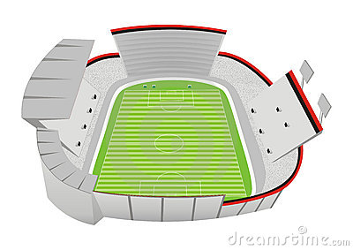
Faulty Survey Questions
When analyzing the results of a survey using questionnaires, you should be sure that the questions are properly written since the way questions are phrased can often influence the way people answer them.
Very Different
Do you feel that the North Huntingdon School District should build a new football stadium?
Do you favor increasing school taxes so that the North Huntingdon School District can build a new football stadium?
Do you feel that the North Huntingdon School District should build a new football stadium?
Do you favor increasing school taxes so that the North Huntingdon School District can build a new football stadium?
Do you feel that the North Huntingdon School District should build a new football stadium?
Do you favor increasing school taxes so that the North Huntingdon School District can build a new football stadium?
Very Similar

Slide 14
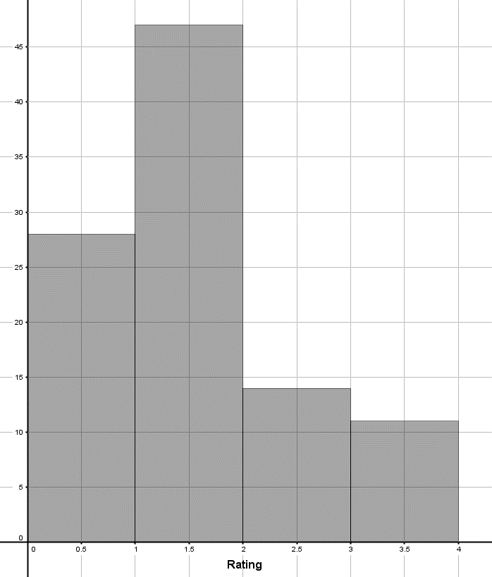
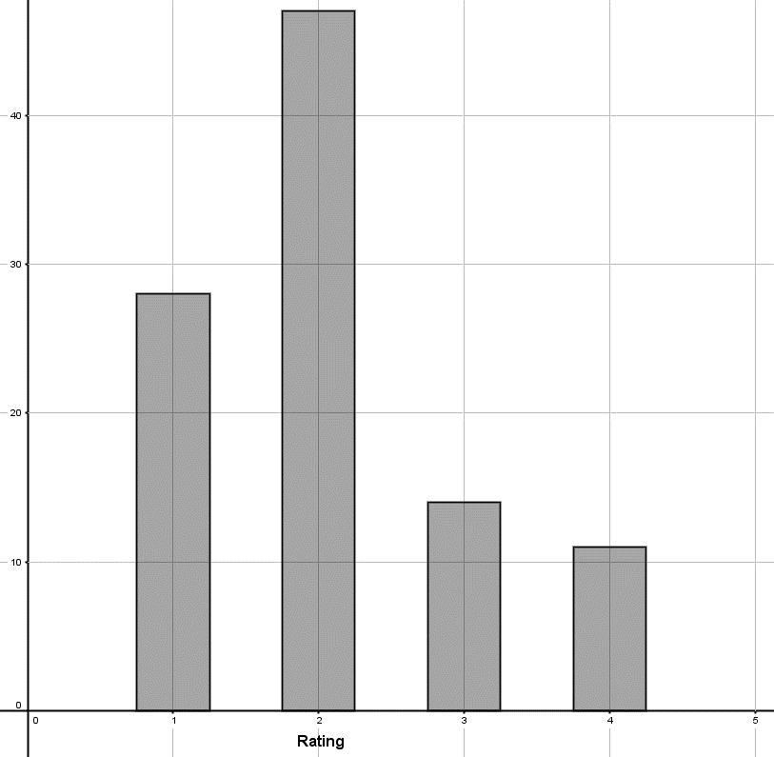
There are some grey areas in statistics…
A small town surveyed their residents to see how they rate their city services. They were asked to rank the service they receive on a scale of 1 to 4, (1= bad, 2 = adequate, 3 = good, and 4 = outstanding). Below are two graphs that were created with the survey results (both represent the same data). Graph A Graph B

Slide 15
Summary
Statistics used properly, can be beneficial in the information obtained.
Statistics used improperly, can result in inaccurate information and incorrect conclusions.

