Slide 1
Chapter 13
Correlation and Regression
a - Using technology, draw a scatterplot for a set of ordered pairs
b - Compute the correlation coefficient.
c - Test the hypothesis $H_{0}: ρ=0$
d - Using technology, compute the equation of the regression line.
e - Compute the coefficient of determination.

Slide 2
Thus far we’ve used inferential statistics to make observations about a population parameter based on sample statistics.
“One can say with 99% confidence that the average high temperature in Toppenish during the month of July is between 86° and 99° Fahrenheit.
“There is enough evidence to support the claim that the average foot-long Subway sandwich is 11 inches”.
Now we will use inferential statistics to determine whether a relationship between two or more quantitative variables exists.

Slide 3
Introduction
Correlation is a statistical method used to determine whether a linear relationship between variables exists.
Is there a relationship between smoking and sleeping?
Is there a relationship between the hours you spend studying and your grade on the next test?
Is there a relationship between the number of siblings you have and the amount of spaghetti your family eats?
Beware! Correlation does not imply causation.
A correlation can be considered evidence for a possible causal relationship but should not be used to indicate what the causal relationship is. Further evidence is needed to substantiate such claims.

Slide 4
An observational study
Results: There is evidence that estrogen therapy decreases risk for coronary heart disease and for hip fracture, but long-term estrogen therapy increases risk for endometrial cancer and may be associated with a small increase in risk for breast cancer. The increase in endometrial cancer risk can probably be avoided by adding a progestin to the estrogen regimen for women who have a uterus, but the effects of combination hormones on risk for other diseases has not been adequately studied.
What potential consequences might this have?
How might a doctor use this information?
What if the FDA were to approve a label change on HRT drugs to include heart disease prevention as one of the treatable symptoms?

Slide 5
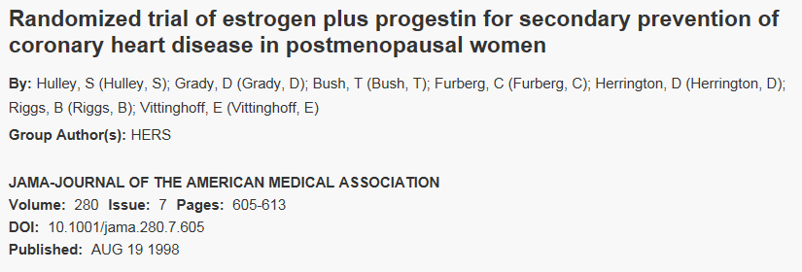
An experimental study
Conclusions. - During an average follow-up of 4.1 years, treatment with oral conjugated equine estrogen plus medroxyprogesterone acetate did not reduce the overall rate of CHD events in postmenopausal women with established coronary disease. The treatment did increase the rate of thromboembolic events and gallbladder disease. Based on the finding of no overall cardiovascular benefit and a pattern of early increase in risk of CHD events, we do not recommend starting this treatment for the purpose of secondary prevention of CHD. However, given the favorable pattern of CHD events after several years of therapy, it could be appropriate for women already receiving this treatment to continue.
Subsequent investigation revealed that socioeconomic factors are associated with hormone replacement therapy. Furthermore, another study shows that socioeconomic factors are associated with coronary heart disease.
This implies that the original observational study did not take into account the possibility of the confounding variable: socioeconomic status.
Source: International Journal of Epidemiology retrieved from http://ije.oxfordjournals.org/content/33/3/464.full#ref-4

Slide 6
Using correlation we will explore these questions:
1. Are two or more variables related?
2. If so, what is the strength of the relationship?
To answer these two questions, statisticians use the correlation coefficient, a numerical measure (statistic) to determine whether two or more variables are related and to determine the strength of the relationship between or among the variables.

Slide 7
3. What type of relationship exists?
There are two types of relationships: simple and multiple. Our focus will be on simple relationships.
In a simple relationship, there are two variables: an independent variable (predictor variable) and a dependent variable (response variable).
Determine the independent and the dependent variable:
Is there a relationship between smoking and sleeping?
Is there a relationship between the hours you spend studying and your grade on the next test?
Is there a relationship between arm length and leg length?
It is not always clear which is the independent and dependent variable.

Slide 8
3. What type of relationship exists? (ctnd)
Simple relationships can also be described as either positive or negative.
Positive relationship: both variables increase or decrease together.
Negative relationship: as one variable increases, the other decreases and vice versa.
Identifying whether a simple relationship is positive or negative can be most easily determined by graphing.

Slide 9
4. What kind of predictions can be made from the relationship?
Predictions are made daily in all areas. Examples include weather forecasting, crop predictions, gasoline price predictions, and sports predictions. Some predictions are more accurate than others, due to the strength of the relationship. That is, the stronger the relationship is between variables, the more accurate the prediction is.

Slide 10
Correlation: does a relationship exist and how strong is it?
The correlation coefficient computed from the sample data measures the strength and whether the linear relationship between two variables is positive or negative.
There are several types of correlation coefficients. The one explained in this section is called the Pearson product moment correlation coefficient (PPMC).
The symbol for the sample correlation coefficient is r. The symbol for the population correlation coefficient is ρ (rho).

Slide 11
The Correlation Coefficient, r.
The range of the correlation coefficient is from −1 to +1.
If there is a strong positive linear relationship between the variables, the value of r will be close to +1.
If there is a strong negative linear relationship between the variables, the value of r will be close to −1.

Slide 12
Regression
Regression is a statistical method used to describe the nature of the relationship between variables—that is, positive or negative, linear or nonlinear.
This method also helps us to produce an algebraic model (an equation) for the relationship that we can use to make predictions.

Slide 13
Scatterplots
Scatterplots help us to determine visually both the strength and the type of relationship between variables.
A scatterplot is a graph of the ordered pairs $(x, y)$of numbers consisting of the independent variable $x$ and the dependent variable $y$.

Slide 14
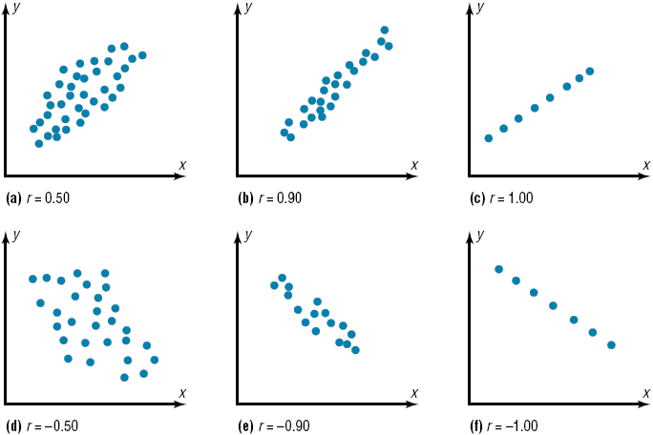
Correlation visually (does a relationship exist, and if so, what is the strength?)

Slide 15
All of the previous examples suggest linear (straight line) relationships. There are other types of relationships like the one below.
A curvilinear relationship
Although methods for analyzing non-linear relationships are beyond the scope of this class, many of the same principles apply.

Slide 16
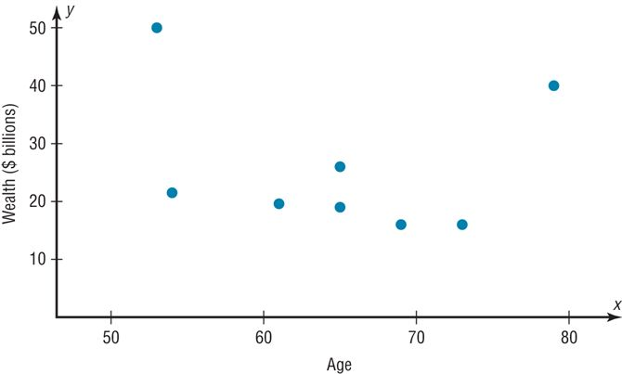
Furthermore, sometimes you will find that there is no discernible pattern as shown in the example below.

Slide 17
Example: Car Rental Companies
Construct a scatter plot for the data shown for car rental companies in the United States for a recent year.
We will answer the following questions about the correlation between the two variables:
What is the correlation coefficient, $r$, rounded to 3 decimal places?
Is the relationship positive or negative?
What is the strength of the relationship?

Slide 18
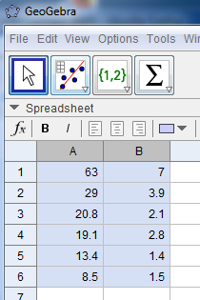
Step 1: Using the spreadsheet view in GeoGebra type the values in columns A and B. (independent variable, x, goes in the first column and the dependent variable, y, goes in the second column.
Step 2: Highlight both columns and select the “Two Variable Regression Analysis” tool.

Slide 19
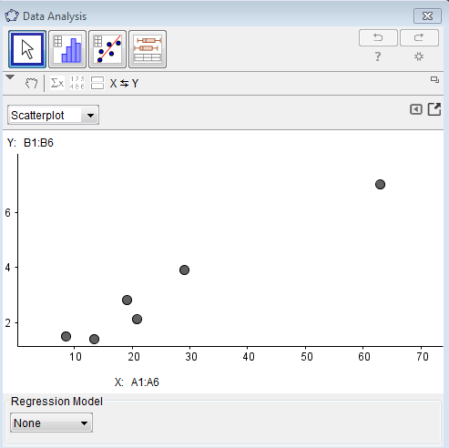
Step 3: Click on the show statistics button.
Questions:
What is the correlation coefficient, r, rounded to 3 decimal places?
Is the relationship positive or negative?
What is the strength of the relationship?

Slide 20
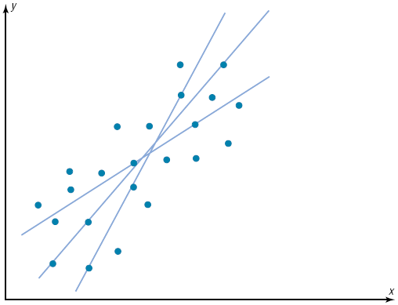
Regression lines
Now we will determine the equation of the regression line which is the data’s line of best fit.
It is important to note that in the absence of a correlation between the two variables, a model would have no practical application.

Slide 21
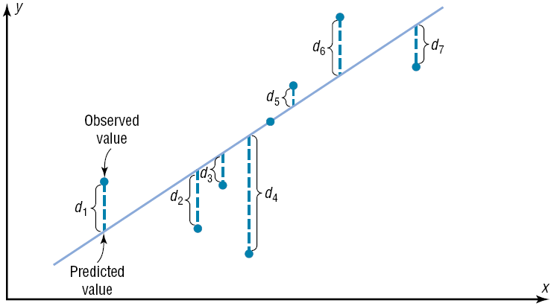
Regression
Best fit means that the sum of the squares of the vertical distance from each point to the line is minimized.
Least squares demo: https://www.geogebra.org/m/dlsxY1uX
Notes:
Least squares demo: https://www.geogebra.org/m/dlsxY1uX

Slide 22
Regression Line

Slide 23
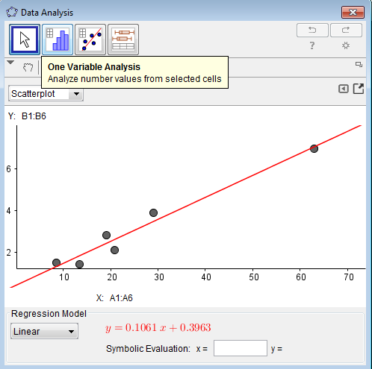
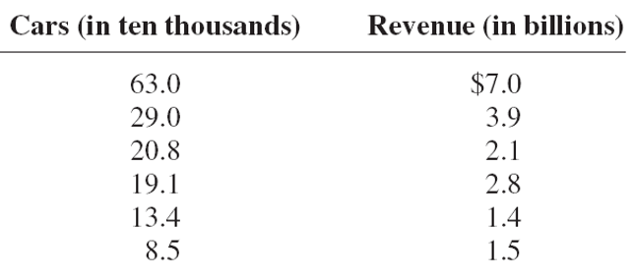
Finding the regression line and linear regression model.
Step 4: Click on the regression model button and choose linear.

Slide 24
Using the Regression model
Extrapolation, or making predictions beyond the bounds of the data, must be approached cautiously.
Remember that when predictions are made, they are based on present conditions or on the premise that present trends will continue. This assumption may or may not prove true in the future.
Furthermore, for valid predictions, the value of the correlation coefficient must be significant.
When r is not significantly different from 0, the best predictor of y is the mean of the data values of y.

Slide 25
Questions:
What is the linear regression model?
What does the model predict for the revenue if 400,000 cars are rented?

Slide 26
Key question to consider:
If we can find a linear model for any two variables, is it ever inappropriate to use the model to make predictions?

Slide 27
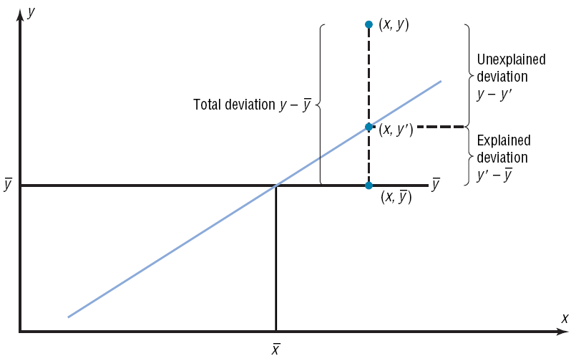
Variation

Slide 28
The Coefficient of Determination: $r^{2}$
The coefficient of determination is the ratio of the explained variation to the total variation.
It is a measure of the variation of the dependent variable that is explained by the regression line and the independent variable.
The symbol for the coefficient of determination is $r^{2}$.
You can obtain the value for r ² by squaring the correlation coefficient.

Slide 29
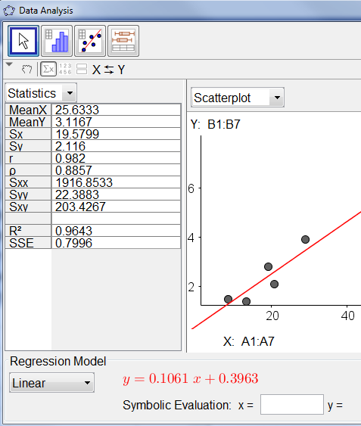
Making sense of the coefficient of determination
If the coefficient of determination $r^{2}=0.96$ or 96%, this means that 96% of the variation of the dependent variable (y) is accounted for (or can be explained) by the variations in the independent variable.
In other words, 96% of the variation in revenue is explained by the variations in the number of cars sold.

Slide 30
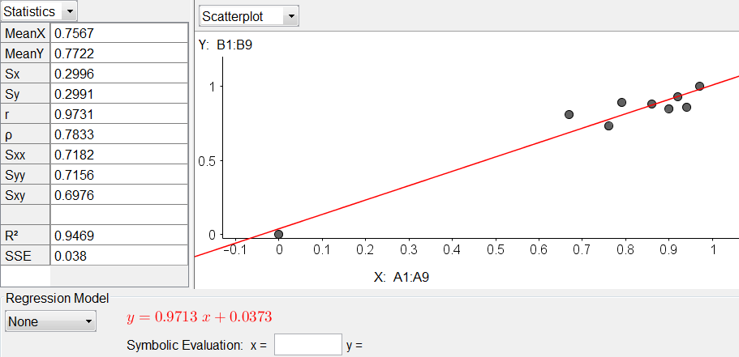
The independent variable is score on the chapter 8 written homework, the dependent variable is the score on the chapter 7/8 assessment.
Describe what the $r$, $r^{2}$ values mean

