Slide 1
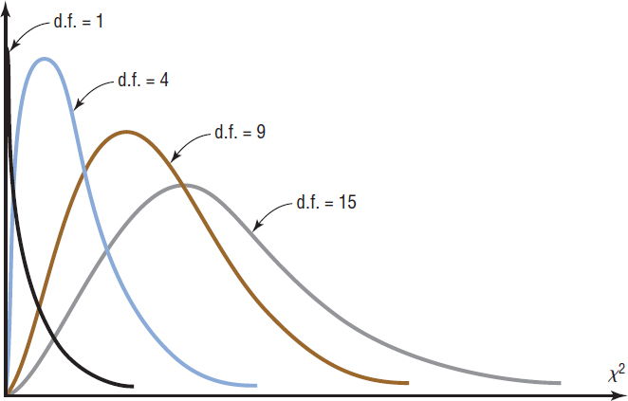
Chapter 11 Section 2
11-2 Chi-squared ($χ^{2}$) Test for Independence
 | Live at Home | Live on own
Male | 11 | 4
Female | 13 | 8
Test the claim that a student’s living situation is independent of gender.
The Chi–square (or $χ^{2})$Family of Curves:

Slide 2
11.2 Chi Squared Test for Independence
The chi squared test for independence tests whether two categorical variables are independent of one another. The data is often summarized in a contingency table.
A contingency table is a two-way frequency table for categorical data that has at least two rows and two columns.
A large furniture retailer with stores in three cities had the following results from a special weekend sale.
Suppose a new postoperative procedure is administered to a group of patients at a particular hospital.
Chi Square Test for Independence tests the null hypothesis which states the variables in the rows and columns are independent of one another.

Slide 3
Chi Squared Test for Independence
Assumptions for Test of Goodness of Fit
Identify the variable and the level of measurement.
The data are obtained from a random sample.
The expected frequency for each category must be 5 or more.
The hypotheses are:
H₀: The two variables are independent (no relationship).
H₁: The two variables are dependent (there is a relationship the two variables).
If the null hypothesis is rejected, there is some relationship between the variables.

Slide 4
Contingency Tables – Degrees of Freedom
The degrees of freedom for any contingency table are d.f. = (# rows – 1) (# columns – 1)
= (R – 1)(C – 1).
Don’t count the labels or the totals.

Slide 5
Example: Hospitals and Infections
A researcher wishes to see if there is a relationship between the hospital and the type of patient infections. A sample of 3 hospitals was selected, and the number of infections for a specific year has been reported. The data are shown next.
Degrees of freedom are calculated as:
(#rows – 1) x (# columns – 1)
Do not count labels or totals.

Slide 6
Example: Hospitals and Infections
Step 0: Assumptions
Step 1: State the hypotheses and identify the claim.
H₀: The type of infection is independent of the hospital.
H₁: The type of infection is dependent on the hospital (claim).
Step 2: Find the critical value.
The critical value at α = 0.05
d.f. = (# rows – 1) x (# columns – 1)
= (3 – 1)(3 – 1) =(2)(2) = 4
we can use GeoGebra to find the CV (see next slide)

Slide 7
Use GeoGebra to find the critical value 1) Select Chi-Squared distribution and enter the correct d.f. 2) Select right-tail test and enter your alpha value

Slide 8
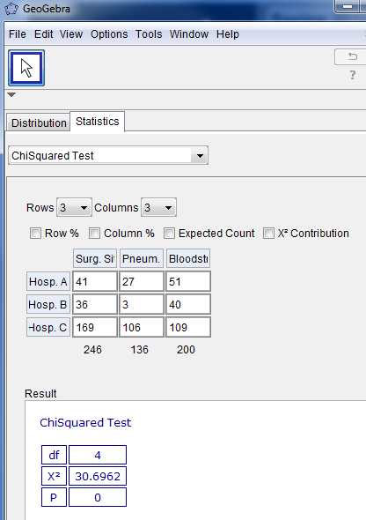
Step 3: the Test value
In GeoGebra:
Select ChiSquared Test from the Statistics tab
For this example there were 3 rows and 3 columns
3) You can label each column and row in terms of what they represent.
4) Fill in the given information.
5) The degrees of freedom and $χ^{2}$ test value are summarized in the results.
Note: You may click the expected count if you want to see the expected values.
The test value is being computed from the formula: $χ^{2}= \sum{\frac{{\left(O −E\right)}^{2}}{E}}$. Slides showing how to do it manually are at the end of the slide show.

Slide 9
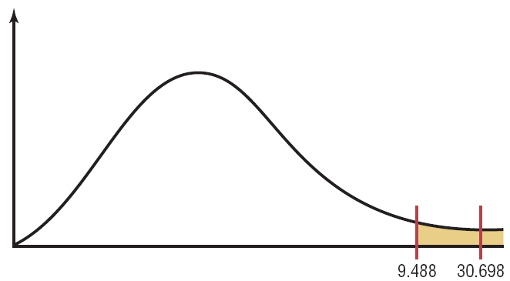
Step 4: Make the decision.
The decision is to reject the null hypothesis since
30.698 is in the critical region.
Step 5: Summarize the results.
There is enough evidence to support the claim that the type of infection is related to the hospital where they occurred.
First recall our hypotheses:

Slide 10
Example: Alcohol and Gender
A researcher wishes to determine whether there is a relationship between the gender of an individual and the amount of alcohol consumed.
A sample of 68 people is selected, and the following data are obtained.
At α= 0.10 can the researcher conclude that alcohol consumption is related to gender?
Alcohol Consumption
Gender | Low | Moderate | High | Total
Male | 10 | 9 | 8 | 27
Female | 13 | 16 | 12 | 41
Total | 23 | 25 | 20 | 68

Slide 11
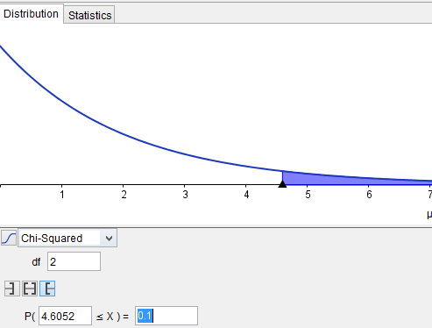
Example: Alcohol and Gender
Step 0: Assumptions
Step 1: State the hypotheses and identify the claim.
H₀: The amount of alcohol that a person consumes is independent of the individual’s gender.
H₁: The amount of alcohol that a person consumes is dependent on the individual’s gender (claim).
Step 2: Find the critical value.
d.f. (2 – 1)(3 – 1) = 2
CV: $χ^{2}$= 4.6052

Slide 12
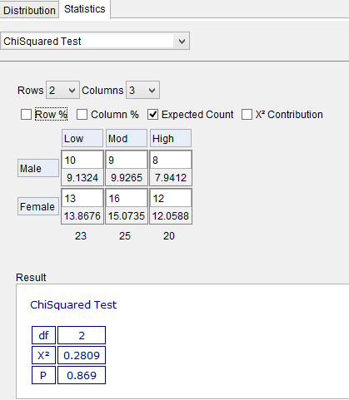
Example: Alcohol and Gender
Step 3: Find the critical value.

Slide 13
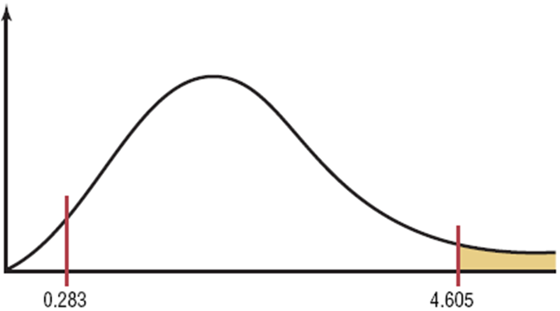
Example: Alcohol and Gender
Step 3: Compute the test value. $χ^{2}= 0.2809$from GeoGebra
Step 4: Make the decision.
Do not reject the null hypothesis
Step 5: Summarize the results.
There is not enough evidence to support the claim that the amount of alcohol a person consumes is dependent on the individual’s gender.

Slide 14
The following slides shows how the test value for a chi-squared test for independence is calculated manually. The example used to demonstrate this process is the hospitals and infections example.
In order to test the null hypothesis, one must compute the expected frequencies, assuming the null hypothesis is true.

Slide 15
Example: Hospitals and Infections
First compute the expected values:
Let’s see where these calculated values end up on the next slide.

Slide 16
Example: Hospitals and Infections
Observed vs Expected

Slide 17
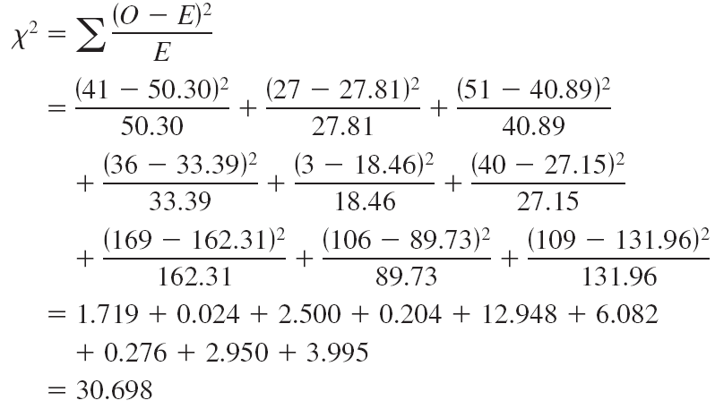
Example: Hospitals and Infections
Step 3: Compute the test value.

