Slide 1
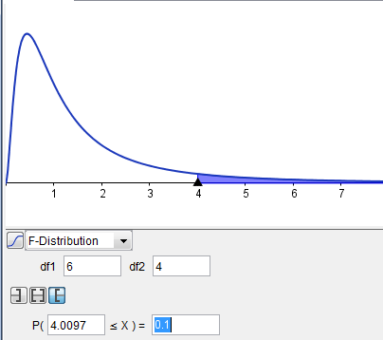
Chapter 14: Analysis of Variance (ANOVA)
14-1 | One-Way Analysis of Variance: Using the one-way ANOVA technique to determine if there is a significant difference among three or more means
$$F=\frac{s_{B}^{2}}{s_{W}^{2}}$$

Slide 2
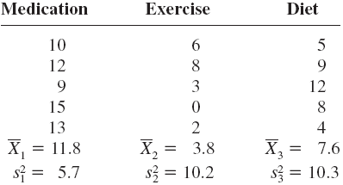
Using the F test to compare three or more means
The technique we will use is called an analysis of variance or ANOVA.
When would you use this type of test?
A marketing analyst wants to know whether the average number of calories for fast-food sandwiches differs among Burger King, McDonalds, and Carl’s Jr.
A researcher is interested in seeing if there is a difference in the average annual child-care in three neighboring counties in his state.
A healthcare official wants to ascertain whether blood pressure differs among three different treatment strategies: medication, diet, and exercise.

Slide 3
Assumptions for One-Way ANOVA
About the Hypothesis test for a one-way ANOVA
The populations from which the samples were obtained are normally distributed
The dependent variable is an interval/ratio level of measurement.
The variances of the populations are equal
The samples are independent of one another
We will follow the same 5 step process we’ve become accustomed to so far.
Here are a couple of differences:
The hypotheses will be written as a comparison of 3 or more means:
In general,
$$H_{0}:μ_{1}=μ_{2}= μ_{3}= ⋯= μ_{n}$$
$$H_{1}:At least one mean is different from the others$$

Slide 4
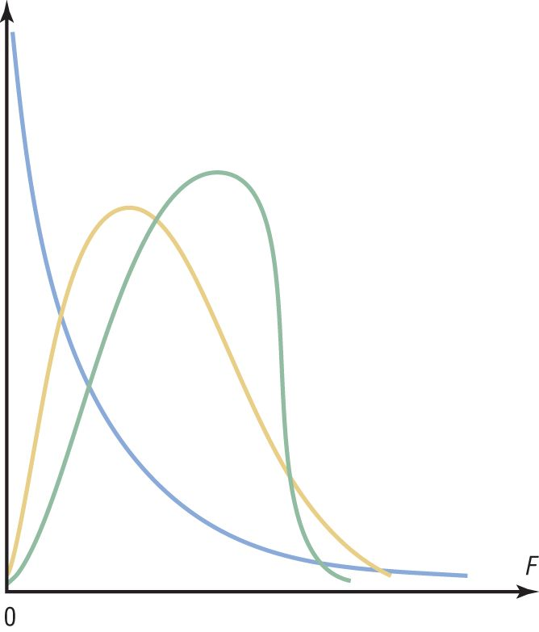
About the F-distribution used for the ANOVA
The F-test can be used to used to compare two variances, but can also be used to compare three or more means
The F Family of Curves:
The F distribution is a distribution of the f statistic, $F= \frac{{\left(s_{1}\right)}^{2}}{{\left(s_{2}\right)}^{2}}$ (the ratio of the variances from two independent samples).
The F distribution is positively skewed and the F-test to compare means is always right-tailed
The F distribution’s family of curves depends on two degrees of freedom: the d.f. of the numerator, and the d.f. of the denominator.

Slide 5
About the Hypothesis test for a one-way ANOVA
(ctnd)
2) The test value is $F=\frac{s_{B}^{2}}{s_{W}^{2}}$
where
B represents “Between groups”, and
W represents “Within groups”
and where
degrees of freedom of the numerator is: d.f.N. = k – 1 and,
degrees of freedom of the denominator is: d.f.D. = N – k
k is the number of groups, and
N is the sample size of all k groups together.
The sample sizes need not be equal!
Furthermore, to compute F,
and
where

Slide 6
More about the F Test
In the F test, two different estimates of the population variance are made (between group and within group)
The first estimate is called the between-group variance, and it involves finding the variance of the means.
The second estimate, the within-group variance, is made by computing the variance using all the data and is not affected by differences in the means.
$$F=\frac{s_{B}^{2}}{s_{W}^{2}}$$

Slide 7
More about the F test (ctnd)
$$H_{0}:μ_{1}=μ_{2}= μ_{3}= ⋯= μ_{n}$$
$$H_{1}:At least one mean is different from the others$$
If there is no difference in the means, the between and within group variances will be approximately equal.
(F test value will be close to 1) Do not reject $H_{0}$.
When the means differ significantly, the between-group variance will be much larger than the within-group variance.
(F test will be significantly greater than 1) Reject $H_{0}$.
$$F=\frac{s_{B}^{2}}{s_{W}^{2}}$$
$$≈\frac{s^{2}}{s^{2}}$$
$$≈1$$
$$≈\frac{\begin{aligned}Large \\ number\end{aligned}}{\begin{aligned}small \\ number\end{aligned}}$$
$$F=\frac{s_{B}^{2}}{s_{W}^{2}}$$
$$≈number>1$$

Slide 8
Example: Lowering Blood Pressure
A researcher wishes to try three different techniques to lower the blood pressure of individuals diagnosed with high blood pressure. The subjects are randomly assigned to three groups; the first group takes medication, the second group exercises, and the third group follows a special diet. After four weeks, the reduction in each person’s blood pressure is recorded. At α = 0.05, test the claim that there is no difference among the means.

Slide 9
Example : Lowering Blood Pressure
A researcher wishes to try three different techniques to lower the blood pressure of individuals diagnosed with high blood pressure. The subjects are randomly assigned to three groups; the first group takes medication, the second group exercises, and the third group follows a special diet. After four weeks, the reduction in each person’s blood pressure is recorded. At α = 0.05, test the claim that there is no difference among the means.
Step 0: Assumptions
The populations from which the samples were obtained are normally distributed
The dependent variable is an interval/ratio level of measurement.
The variances of the populations are equal
The samples are independent of one another
Step 1: State the hypotheses and identify the claim.
H₀: μ₁ = μ₂ = μ₃ (claim)
H₁: At least one mean is different from the others.

Slide 10
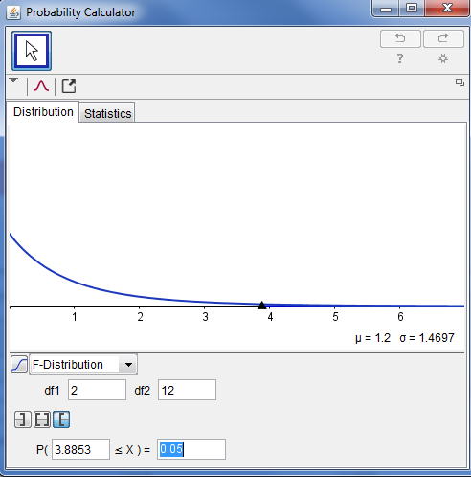
Step 2: Find the critical value.
Since k = 3, N = 15,
and α = 0.05,
d.f.N. = k – 1 = 3 – 1 = 2
d.f.D. = N – k = 15 – 3 = 12
The critical value is 3.89, obtained from Appendix E (textbook) or from the GeoGebra Probability Calculator.

Slide 11
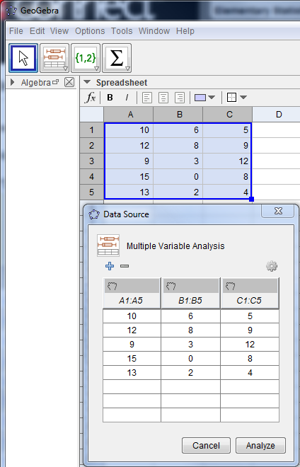
Step 3: Compute the test value.
Enter the values in 3 columns in spreadsheet view.
Select all values and click on the “Multiple Variable Analysis” button.
3. Click Analyze

Slide 12
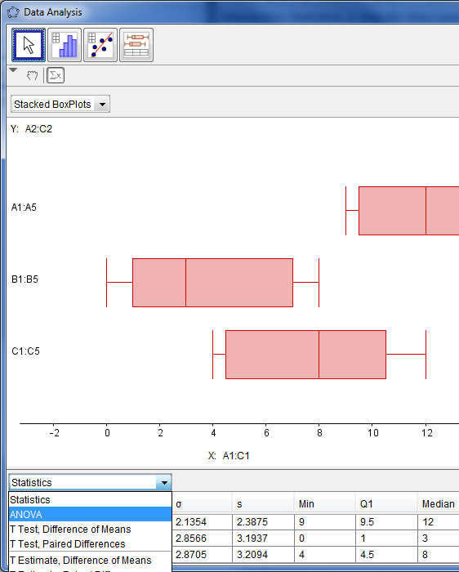
Step 3: Compute the test value (continued).
4. Click the Show Statistics button.
5. In the statistics drop down list, select ANOVA.

Slide 13
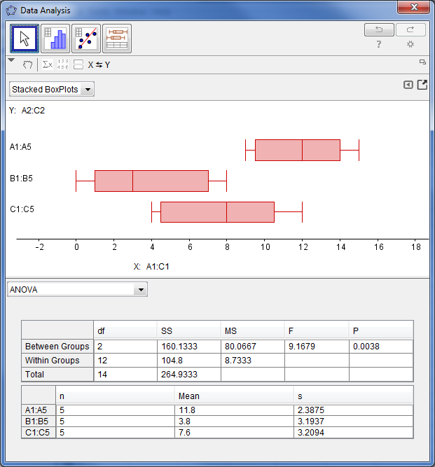
Step 3: Compute the test value (continued).
6. Record your F test value.
Notice that the d.f. are computed for you?
** Be efficient:
you could run the ANOVA test in GeoGebra first, then use the results to find your critical values based on the d.f. that are given.

Slide 14
Step 4: Make the decision.
Reject the null hypothesis, since the critical value is 3.89 and the test value f=9.17 is in the critical region for a right-tailed test.
Step 5: Summarize the results.
There is enough evidence to reject the claim that the means are the same.
Note that this suggests that at least one mean is different from the others. Another statistical test can be used to determine which one is different.

Slide 15
Some important things to note:
For three groups, the F test can only show whether or not a difference exists among the three means, not where the difference lies.
Other statistical tests, Scheffé test and the Tukey test, are used to find where the difference exists.
You might be wondering why we don’t just use the t test. The t test was used to compare two means. It should not be used to compare three or more because
it would require you to do comparisons of two groups at a time. When you compare 2 means, the other means are ignored. The ANOVA tests all means simultaneously.
If you are testing 3 means with a t-test, you’d need to run the test 3 times. If you were testing 5 means, you would need to run the t-test 10 times. You only need to run an F-test once.
When you run multiple t-tests instead of one F –test you are increasing your probability of making a type one error.

Slide 16
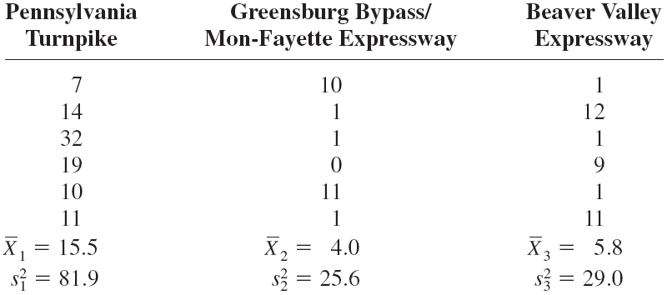
Example: Toll Road Employees
A state employee wishes to see if there is a significant difference in the number of employees at the interchanges of three state toll roads. The data are shown. At α = 0.05, can it be concluded that there is a significant difference in the average number of employees the interchanges?

Slide 17
Example: Toll Road Employees (continued)
Step 1: Assumptions:
The populations from which the samples were obtained are normally distributed
The dependent variable is an interval/ratio level of measurement.
The variances of the populations are equal
The samples are independent of one another
Step 1: State the hypotheses and identify the claim.
H₀: μ₁ = μ₂ = μ₃
H₁: At least one mean is different from the others (claim).

Slide 18
Example : Toll Road Employees
Let’s do this together. Run the ANOVA test and we will find our test value and critical value from the results.
Step 2: Find the critical value.
Step 3: Compute the test value.
Notes:
Step 3: Find the test value.
Since k = 3, N = 18, and α = 0.05,
d.f.N. = 2, d.f.D. = 15
The critical value is 3.68, obtained from Table H.

Slide 19
Example: Toll Road Employees
Step 4: Make the decision.
Step 5: Summarize the results.
Notes:
Step 4: Make the decision.
Reject the null hypothesis, since 5.05 > 3.68.
Step 5: Summarize the results.
There is enough evidence to support the claim that there is a difference among the means.

Slide 20
ANOVA Summary Tables
The between-group variance is sometimes called the mean square, MS_{B}.
The within-group variance is sometimes called the mean square, MS_{W}.
If you are calculating the test value by hand:
The numerator of the formula to compute MS_{B} is called the sum of squares between groups, SS_{B}.
The numerator of the formula to compute MS_{W} is called the sum of squares within groups, SS_{W}.
ANOVA Summary table from Toll Road Employees example

Slide 21
Note Regarding Example 1
The following slides demonstrate hand calculations required to do an ANOVA by hand.
Geogebra will run the ANOVA test for you. However, it may be useful for you to view the next four slides to that you can appreciate what technology does for you in terms of running the tests and obtaining the results from a software program.

Slide 22
Computing the test value (by hand) Example: Lowering Blood Pressure
Step 3: Compute the test value.
Find the mean and variance of each sample (these were provided with the data).
Find the grand mean, the mean of all
values in the samples.
c. Find the between-group variance, .

Slide 23
Step 3: Compute the test value. (continued)
c. Find the between-group variance, .
Find the within-group variance, .
e. Compute the F value.

Slide 24
Computing the Test Value (by hand) Example: Toll Road Employees
Step 3: Compute the test value.
Find the mean and variance of each sample (these were provided with the data).
Find the grand mean, the mean of all
values in the samples.
c. Find the between-group variance,

Slide 25
Step 3: Compute the test value. (continued)
c. Find the between-group variance,
Find the within-group variance,
e. Compute the F value.

