Slide 1
Ch 9 Fundamentals of Hypothesis Testing

Slide 2
What Will I Learn in Ch 9 Fundamentals of Hypothesis Testing?
Objectives:
Learn the 5 steps of hypothesis testing (Traditional Method).
Learn how to identify the three considerations in regard to assumptions before the hypothesis test.
Learn to identify and write the null hypothesis and alternative hypothesis.
Learn to identify the claim in a hypothesis test.
Learn what a critical value is and what it represents.
Learn what the critical region is and what it represents.
Learn what the alpha represents.
Learn to identify which type of hypothesis test (right-tail, left-tail, two-tail).
Learn the relationship between the alpha value and the error type (type I and type II errors).

Slide 3
Chapter 9 Section 1: Hypothesis Testing
Researchers are interested in answering many types of questions. For example,
Is the earth warming up?
Does a new medication lower blood pressure?
Does the public prefer a certain color in a new fashion line?
Is a new teaching technique better than a traditional one?
Do seat belts reduce the severity of injuries?
These types of questions can be addressed through statistical hypothesis testing, which is a decision-making process for evaluating claims about a population.

Slide 4
Hypothesis Testing
Three methods used to test hypotheses:
1. The traditional method
2. The P-value method
3. The confidence interval method
Our focus for in this class will be the traditional method, however it should be noted that all 3 methods can be used as a decision making process.

Slide 5
Step 0 – Assumptions:
Before a hypothesis test of a mean is ran it is imperative to address three areas of consideration to ensure that the hypothesis test is a valid test to use for the contextual situation.
Identify the variable and ensure that the level of measurement is at the interval-ratio method
Identify the method of sampling. If the specific method is not clearly stated – verify that the subjects or data were randomly selected.
Identify the shape of the population distribution. If there is no indication of normally distributed data – identify the sample size. If $n≥30$ and the distribution is made up of sample means then the Central Limit Theorem guarantees an approximately normal distribution.

Slide 6
8.1
Steps in Hypothesis Testing—Traditional Method
Solving Hypothesis-Testing Problems (Traditional Method)
Step 0 – Assumptions:
Step 1 State the hypotheses and identify the claim.
Step 2 Find the critical value(s) from the appropriate table in Appendix B (or using GeoGebra).
Step 3 Compute the test value.
Step 4 Make the decision to reject or not reject the null hypothesis.
Step 5 Summarize the results.

Slide 7
9.1 Steps in Hypothesis Testing-Traditional Method
A statistical hypothesis is a conjecture about a population parameter. This conjecture may or may not be true.
Examples:
The average age of college students is 24.6 years.
The average score of high school basketball games is less than 88 pts.
The average cost of a BD-DVD player is $79.95.

Slide 8
Step 0 – Assumptions: Step 1 Stating the hypotheses:
There are two components to the hypotheses:
Null Hypothesis ($H_{0})$: a statistical hypothesis that states that there is no difference between a parameter and a specific value or between two parameters
Alternative Hypothesis$\left(H_{1}\right):$ a statistical hypothesis that states the existence of a difference between a parameter and a specific value, or between two parameters.
AND Identifying the Claim:
When a researcher conducts a study, he or she is generally looking for evidence to support a claim.
That claim is either the null ($H_{0}$) or alternative ${ (H}_{1})$hypothesis.

Slide 9
Lets look at some examples
Step 1 Stating the hypotheses and identifying the claim.
Example: The mean depth of water in particular lake is 400 ft, but you claim that it has actually decreased over time.
The Null Hypothesis would be that average has not changed or that the average is still 400 ft.
In other words, there is no difference → $H_{0}$: $μ=$ 400
The alternative hypothesis is that the depth has decreased.
In other words, the depth is less than 400 feet. → $H_{1}$: $μ$< 400 CLAIM
Example: The average college student’s credit card debt is $3262. You claim that the average credit card debt of a college student hasn’t changed.
The Null Hypothesis would be that the average credit card debt for a college student is $3262.
→ $H_{0}$: $μ=$$3262 CLAIM
The alternative hypothesis is that the average credit card debt is different than $3262.
→ $H_{1}:$ $μ$≠ $3262

Slide 10
You try it:
You try it:
The mean lifetime of the automobile battery is 36 months. A chemist invents an additive to increase the life of automobile batteries and wants to show that his results are statistically significant.
A contractor wishes to show that a customer can lower heating bills by using a special type of insulation in houses. If the average of the monthly heating bills is $78, her hypotheses about heating costs with the use of insulation are…

Slide 11
You try it:
A medical researcher is interested in finding out whether a new medication will have any undesirable side effects. She is particularly concerned with the pulse rate of the patients who take the medication. She knows that the mean pulse rate for the population under study is 82 beats per minute. Will the pulse rate be different (increase, decrease, or remain unchanged) after a patient takes the medication?

Slide 12
Before moving on to Step 2, let’s think about the big picture: Hypothesis Testing is only part of the research process
After forming a research question and stating the hypotheses, the researcher’s next step is to design the study. The researcher selects the correct statistical test, chooses an appropriate level of significance, and formulates a plan for conducting the study.
The statistical test uses the data obtained from a sample to produce a test value. There are many different statistical tests to choose from dependent upon the study design and your hypotheses (are you hypothesizing about means, proportions, variability, etc.?)
The statistical test produces a numerical value called the test value.
The level of significance is essentially the probability of obtaining a false positive.
The test value and level of significance are used to to make a decision about whether the null hypothesis should be rejected.

Slide 13
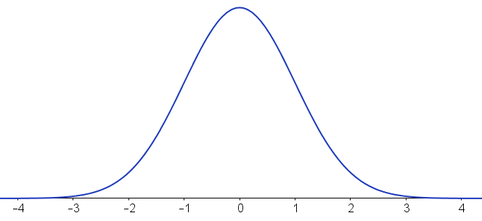
Critical Values
A critical value, C.V., is a boundary point that defines a range of values for the test value that indicate that there is a significant difference and that the null hypothesis should be rejected.
The critical value separates the critical region (I like to call it the “rejection region”) from the noncritical region. The critical regions are always in the tails of the distribution.
When the test value falls into the rejection region, you reject the null hypothesis
The significance level, α, is equal to the area that comprises the critical region(s)
Non-critical region
Critical values
Critical regions

Slide 14
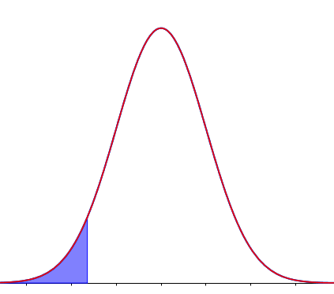
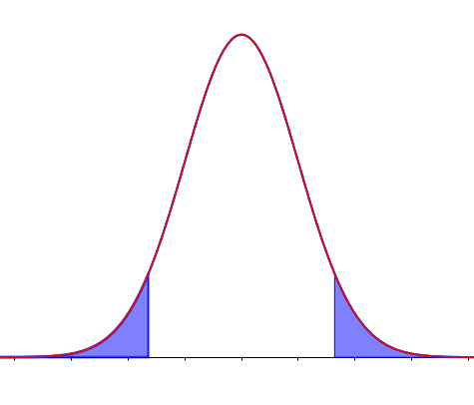
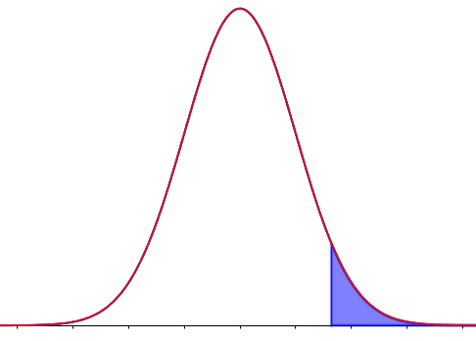
Step 2 Finding the critical value(s)
In order to find the critical values, you MUST FIRST determine which tail (or tails) your critical regions will be in. This is dependent upon the alternative hypothesis H₁
Left-Tailed Test
Right-Tailed Test
Two-Tailed Test
$H_{0}$: µ = $78
$H_{0}$: µ = 36 months
$H_{0}$: µ = 82 beats per minute
$H_{1}: µ$< $78
$H_{1}$: µ > 36 months
$H_{1}$: µ ≠ 82 beats per minute
α
$$\frac{α}{2}$$
$$\frac{α}{2}$$
α
critical values
critical value
critical value

Slide 15
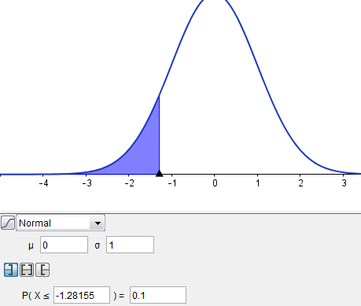
Step 2 Finding the critical value(s)
After you’ve determined which tail (or tails) your critical regions will be in, use alpha and either tables or technology to find the critical value.
Example:
Find the Critical Value for a left-tailed test with α = 0.10.
a. Sketch the problem conceptually
b. Use the left-tail interval button and
α = 0.10 to find the C.V.
α = 0.10
Critical value is z = -1.28

Slide 16
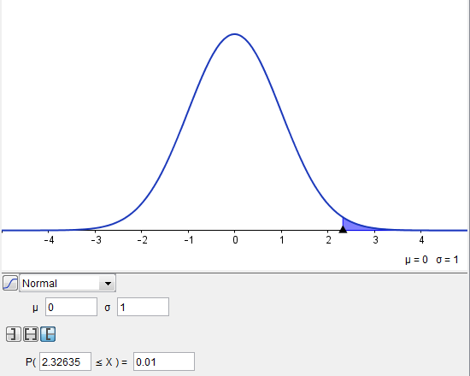
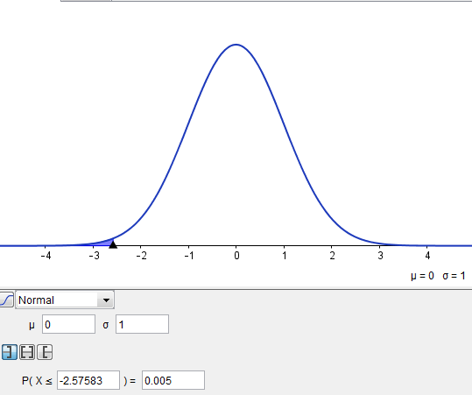
Step 2 Finding the critical value(s): One-tailed examples
Find the Critical Value for α = 0.01 (Right-Tailed Test)
Find the critical value for a Left-tailed test when α = 0.005
The critical value is
z = 2.33 for α = 0.01 (Right-Tailed Test)
The critical value is
z = -2.58 for α = 0.005 (Left-Tailed Test)

Slide 17
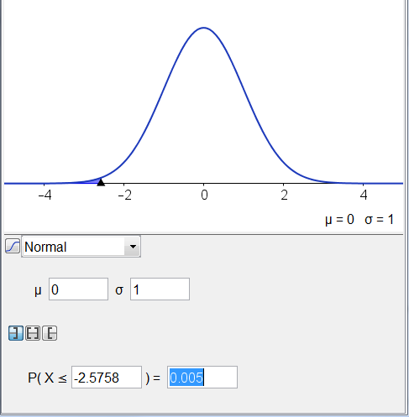
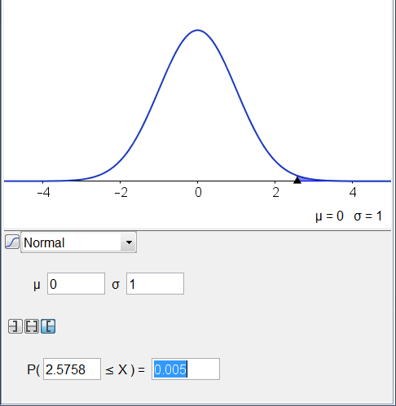
Step 2 Finding the critical value(s): A Two-tailed example
Find the Critical Value for α = 0.01 (two-tailed test)
Alpha must be split equally between the two tails.
α = 0.01
$\frac{α}{2} = 0.005$
The critical values are z = +2.58 and z=-2.58 for a
two-tailed test with α = 0.01

Slide 18
Example: You try it
Find the critical value(s) for each situation and draw the appropriate figure, showing the critical region.
A two-tailed test with α = 0.02.
Step 1 Draw the figure with and shade the area(s) that represent alpha.
Step 2 Find the critical value(s)

Slide 19
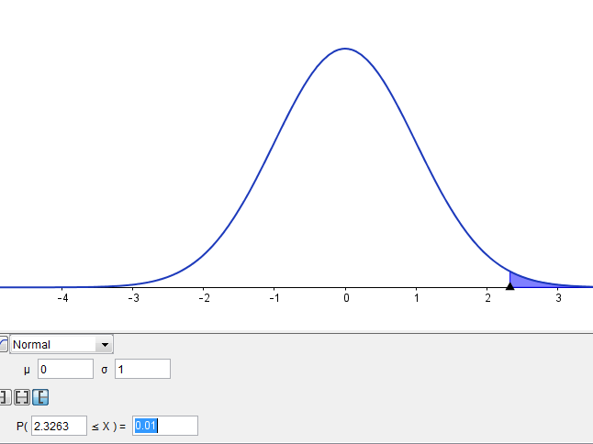
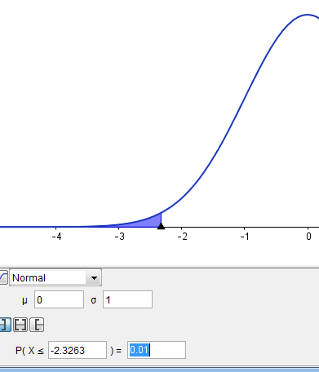
Example: You try it
Find the critical value(s) for each situation and draw the appropriate figure, showing the critical region.
A two-tailed test with α = 0.02. (0.02/2 = .01)
Step 1 Draw the figure with and shade the area(s) that represent alpha.
Step 2 Find the critical value(s)
z = -2.33, 2.33

Slide 20
Example: You try it
Find the critical value(s) for each situation and draw the appropriate figure, showing the critical region.
A right-tailed test with α = 0.005.
Step 1 Draw the figure and shade the critical area.
Step 2 Find the critical value(s)

Slide 21
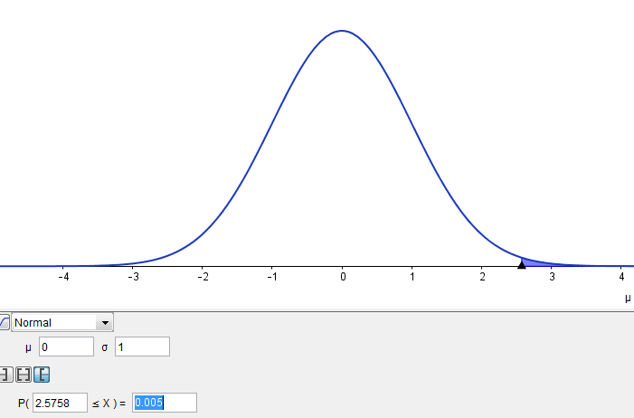
Example: You try it
Find the critical value(s) for each situation and draw the appropriate figure, showing the critical region.
A right-tailed test with α = 0.005.
Step 1 Draw the figure and shade the critical area.
Step 2 Find the critical value(s)
z = 2.58

Slide 22
8.1
Steps in Hypothesis Testing—Traditional Method
Summary of Finding the Critical Values for Specific α Values, Using Appendix B or Geogebra
Draw the figure and indicate the appropriate area.
If the test is left-tailed, the critical region, with an area equal to α, will be on the left side of the critical value.
If the test is right-tailed, the critical region, with an area equal to α, will be on the right side of the critical value.
If the test is two-tailed, α must be divided by 2; one-half of the area will be to the right of the positive critical value, and one-half will be to the left of the negative critical value.
Use GeoGebra or Appendix B to find the critical values.

Slide 23
Hypothesis Testing: Error Type and Levels of Significance Why do we choose α = 0.01 , α = 0.05, or α = 0.1? What does it mean?)
Typical significance levels are:
0.10, 0.05, and 0.01 but others could be used.
When α = 0.10, it means that there is a 10% chance of rejecting a true null hypothesis (AKA a type I error)
β is the probability of not rejecting the null hypothesis when it is false (AKA a type II error). It is not easily computed, but is related to α in that if one of them (α or β) is decreased, the other increases.

Slide 24
Hypothesis Testing: Types of Errors
In reality, the null hypothesis may or may not be true, and a decision is made to reject or not to reject it on the based on the data obtained from a sample.
In the hypothesis-testing situation, there are four possible outcomes (we will see on the next slides) and two possible types of errors.
A type I error occurs if one rejects the null hypothesis when it is true. (this is your alpha level)
A type II error occurs if one does not reject the null hypothesis when it is false.

Slide 25
If we liken hypothesis testing to a jury trial situation, the null hypothesis is the “presumption of innocence”.
Only the defendant truly knows whether H₀ is true or false.
Whether we reject the null or not, we can see that there are 4 possible outcomes (with 2 possible errors).

Slide 26
8.1
Steps in Hypothesis Testing—Traditional Method
Solving Hypothesis-Testing Problems (Traditional Method)
Step 0 – Assumptions:
Step 1 State the hypotheses and identify the claim.
Step 2 Find the critical value(s) using Geogebra or the appropriate table.
Step 3 Compute the test value.
Step 4 Make the decision to reject or not reject the null hypothesis.
Step 5 Summarize the results.

