Slide 1
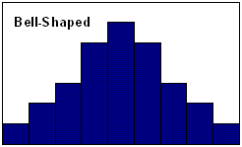
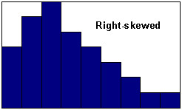
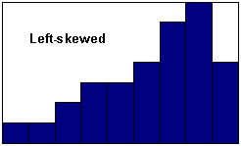
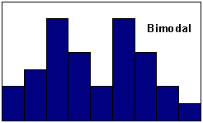
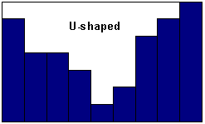
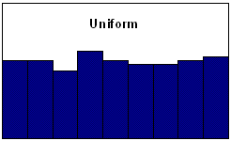
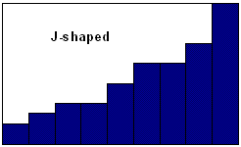
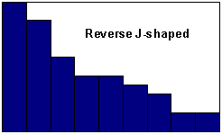
Reading Histograms: Shapes

Slide 2
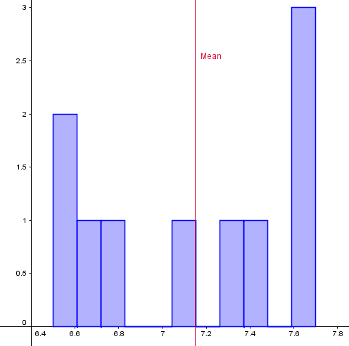
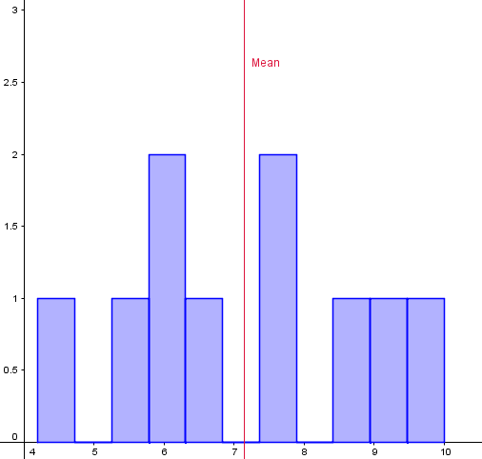
Reading Histograms: Spread
Both have approximately the same mean, but what about the spread?

Slide 3
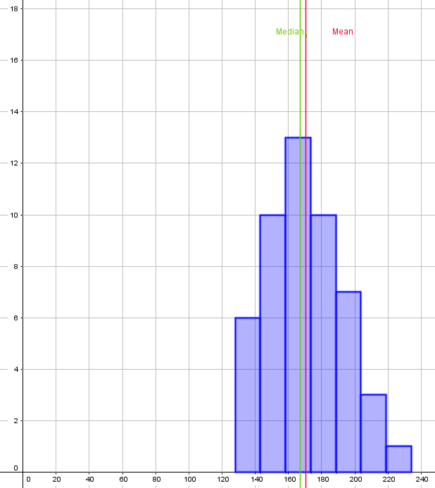
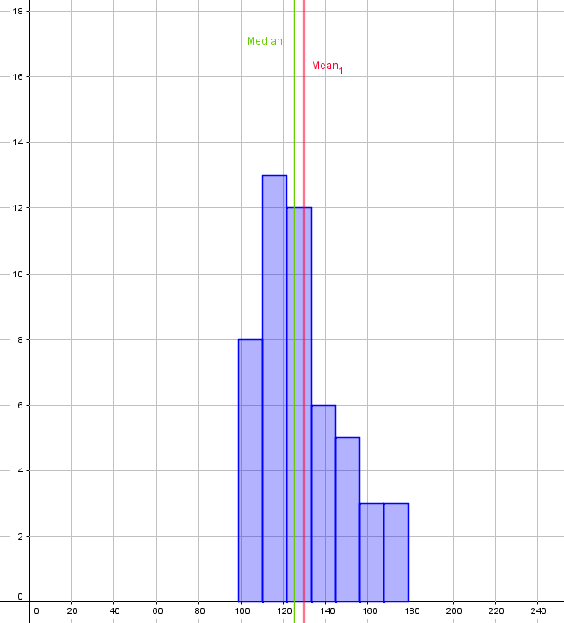
Reading Histograms: Central Tendency (measures of center)

Slide 4
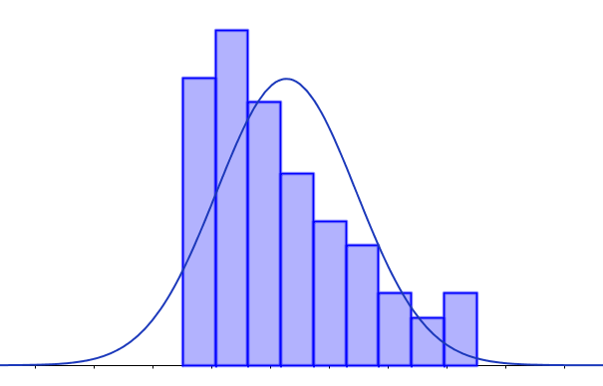
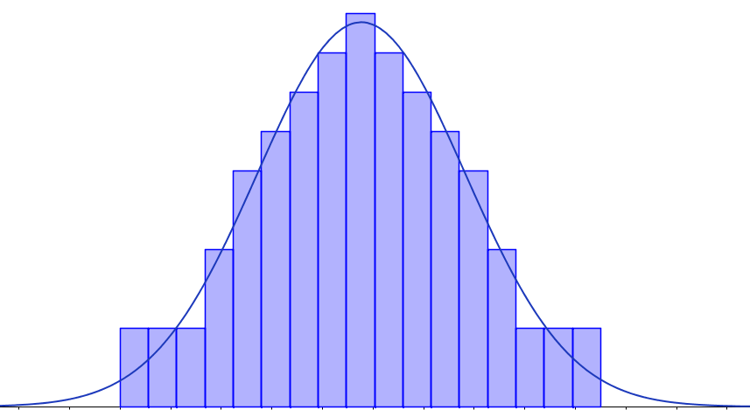
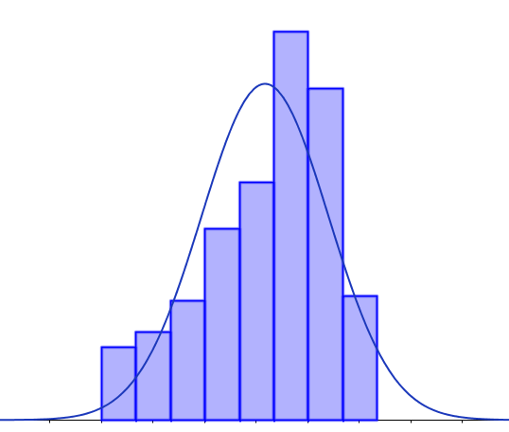
Comparing the mean and median in the distribution
(a) Skewed to the right or positively skewed
Mean > Median
(b) Symmetric
(c) Skewed to the left or negatively skewed
Mean ≈ Median
Mean < Median
Note that a skewed distribution could indicate that there could be an outlier or outliers in your data set.

Slide 5
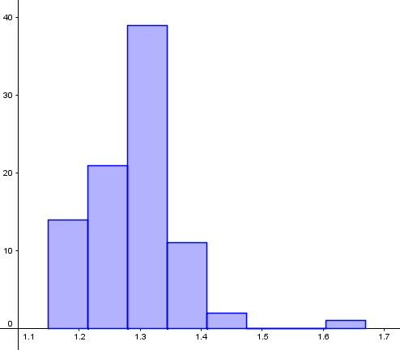
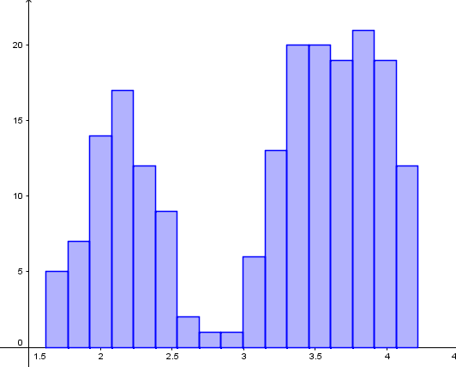
Reading Histograms: Unusual Features
More than one cluster may suggest different populations were sampled
Possible outliers
Gaps

Slide 6
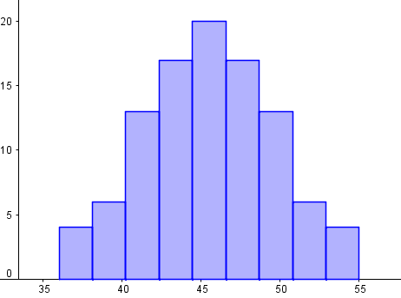
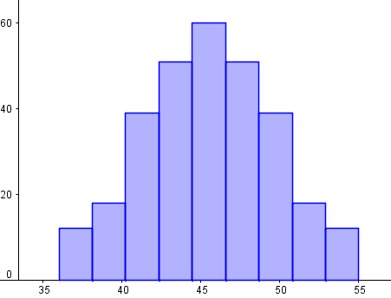
A Note on Sample Size

Slide 7
Lab activity: Comparing Histograms
Objectives:
You will be able to…
run descriptive statistics on two data sets
create histograms using technology on two data sets
Use appropriate technology to summarize figures (descriptive statistics, graphs, etc.) into one document
compare two data sets in terms of measures of spread, distribution shapes, measures of center, unusual features
compare two data sets within the context of the data itself (in this case, in terms of soil density before-and-after clearcut logging).

Slide 8
Lab activity: Comparing histograms and statistical measures in the context of real data
Context:
Soil density is a measure of mass per volume. The units of measure are typically in grams per cubic centimeter (g/cm³). When soil is compacted it becomes more dense and less porous. A decrease in soil porosity can impair vegetation growth and decrease water absorption leading to increased flooding potential.
Clearcut logging practices can compact the soil due to the heavy machinery used and the dragging of logs across the soil.
About the data set:
Reference: Purser, M. D. (1988), The Impact of Clearcut Logging with High-Lead Yarding on Spatial Distribution and Variability of Infiltration Capacities on a Forest Hillslope; M. S. Thesis, University of Washington, 127 pp.
Source: http://www.seattlecentral.edu/qelp/sets/013/013.html#About
Description: Samples of soil were taken and soil densities were measured before and after a forested area was clearcut using high-lead logging methods.

Slide 9
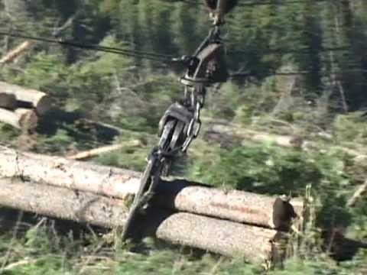
What is high-lead logging?
Source: A journey into B.C.s logging industry: Chapter 4: Full Tree Logging
https://www.youtube.com/watch?v=InsFTpA9vkk

Slide 10
Directions:
Navigate to the MyHeritage Soc 220 course page and open up the Lab Activity: Comparing Histograms assignment.
Download and open both files attached to the assignment.
Everyone must complete the assignment, but you should work together. Save your changes as you go.
When you are finished, either upload the Word file through MyHeritage, or send the file via email to your instructor (depending on your instructor’s preference). You do not need to send the spreadsheet.

