Slide 1
Chapter 8 Confidence Intervals Part A when the Population Standard Deviation is Known

Slide 2
What Will I Learn in Chapter 8 part A?
How to find the confidence interval for the population mean when σ is known.

Slide 3
Making estimations based on samples
Inferential statistics: the branch of statistics that consists of generalizing about a population based on a sample.
Statistical measures used to estimate a population statistic are called estimators.
Types of Estimators
Point Estimates
Interval Estimates
Definition: A specific numerical value estimate of a parameter.
Example: If we took a sample of 30 HU freshman and found the mean age to be 21 and the standard deviation to be 2.75, we could infer that the mean age of all freshman at HU is 21 and that the standard deviation of all freshman at HU is 2.75.
Definition: A range of values used to estimate a parameter.
Example: If we took a sample of 30 HU freshman and found the mean age to be 21 and the standard deviation to be 2.75, we could say with 95% confidence that the mean age of all freshman at HU is between 20 and 22 years, or with 99% confidence that the mean age of all freshman at HU is between 19.7 and 22.3 years.

Slide 4
Clearly from our example of an interval estimate there are 2 distinct parts:
“we could say with 95% confidence that the true mean of the ages of all freshman at HU is
between 20 and 22 years”
The example above is called a confidence interval. The two main components are:
Confidence Level:
The probability that the interval estimate will contain the parameter. (Most often, 90%, 95%, or 99% confidence levels are used).
Confidence Interval:
The interval estimate obtained by using the sample mean and adding/subtracting a margin of error. (The margin of error is a calculation that involves the confidence level).
Important note:
Often times, certain assumptions must be met before using inferential statistic techniques. Some common assumptions may be:
Samples were randomly selected
The sample size is greater than or equal to 30
The sample is normally distributed

Slide 5
Formula for the Confidence Interval of the Mean for when $σ$ (population standard deviation) is known
…the sample mean plus and minus…
$$\overline{X}− z_{α/2}\left(\frac{σ}{\sqrt{n}}\right)< μ<\overline{X}+z_{α/2}\left(\frac{σ}{\sqrt{n}}\right)$$
The population mean is between…
the “margin of error” AKA
“maximum error of the estimate”

Slide 6

$$\overline{X}− z_{α/2}\left(\frac{σ}{\sqrt{n}}\right)< μ<\overline{X}+z_{α/2}\left(\frac{σ}{\sqrt{n}}\right)$$
The margin of error:
“E” the margin of error
The margin of error has two components: a critical value (z-score) and standard deviation. Remember that a z-score simply represents how many standard deviations a value is away from the mean. If we multiply a z-score times the standard deviation, we get the distance a particular value is from the mean.
$$z_{α/2}\left(\frac{σ}{\sqrt{n}}\right)$$
Z-score
or Critical Value
Standard Deviation (accounting for sample size)

Slide 7
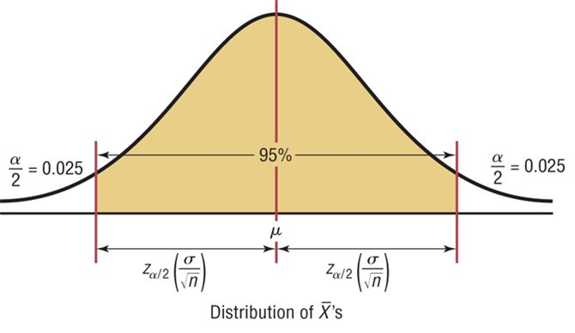
Critical values :
$$\overline{X}− z_{α/2}\left(\frac{σ}{\sqrt{n}}\right)< μ<\overline{X}+z_{α/2}\left(\frac{σ}{\sqrt{n}}\right)$$
Example of what the critical values represent in a 95% confidence interval
$α$ represents the non-shaded area in the tails.
$$α=1 −0.95$$
$$α= .05$$
For a 90% confidence interval, $z_{α/2}=1.65$
critical values for typical confidence levels
For a 95% confidence interval, $z_{α/2}=1.96$
For a 99% confidence interval, $z_{α/2}=2.58$

Slide 8
Rounding Rules for a Confidence Interval for a Mean
When you are computing a confidence interval for a population mean by using raw data, round the confidence level limits to one more decimal place than there was in the original raw data.
When you are given only the summary statistics, round the confidence interval limits to the same number of decimal places used for the sample statistics.
Remember, these rules are not set in stone. Round using common sense. For example, if the data variable is in dollars, it would make sense to round to two decimal places. If the lower bound of the interval is a negative number, but the variable is weight of underweight babies born, then using a zero for the lower bound would make more sense.
Round any intermediate computations to 4 decimal places (again, this is for consistency of homework results, not part of a statistics dogma).

Slide 9
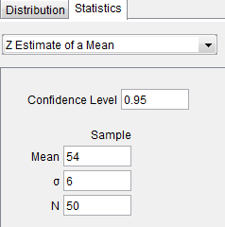
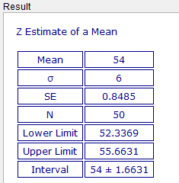
Example: Days It Takes to Sell a Geo Metro
A researcher wishes to estimate the number of days it takes an automobile dealer to sell a Chevrolet Geo Metro. A random sample of 50 cars had a mean time on the dealer's lot of 54 days. Assume the population standard deviation to be 6 days. Find the 95% confidence interval of the population mean.
Using GeoGebra
Step 2: Input the confidence level, sample mean, sample standard deviation and sample size.
Step 1: From the probability calculator, click the statistics tab and choose Z-Estimate of a mean.
Step 3: Press enter and scroll down to your results.

Slide 10
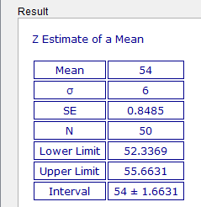
52 < µ < 56
1.6631 is the Margin of Error

Slide 11
Example: Days It Takes to Sell a Geo
A researcher wishes to estimate the number of days it takes an automobile dealer to sell a Chevrolet Geo. A random sample of 50 cars had a mean time on the dealer's lot of 54 days. Assume the population standard deviation to be 6 days. Find the 95% confidence interval of the population mean.
What I expect to see in your written work:
Step 1: Capture a screenshot of your GeoGebra work.
Explicitly identify and write the margin of error (to 4 decimal places).
$$E$$
$$≈1.6631$$
Step 2: Follow the confidence interval formula to write in the values of the mean and margin of error (in inequality notation) and simplify. Round your final interval according to the rounding rule(s) that apply.
$$54−1.6631< μ<54+1.6631$$
$$52.3369< μ<55.6631$$
$$52< μ<56$$
Step 3: make the confidence statement
We can say, with 95% confidence, that the true mean number of days it takes to sell an Geo is between 52 and 56 days.

Slide 12
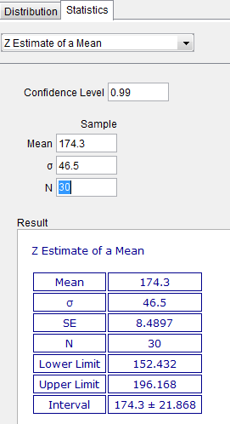
Example: Waiting in the Emergency Room
A survey of 30 randomly selected emergency room patients found that the average waiting time for treatment was 174.3 minutes. Assuming that the population standard deviation is 46.5 minutes find the 99% confidence interval of the population mean.
Step 1: Capture a screenshot of your GeoGebra work.
Explicitly identify and write the margin of error (4 decimal places).
$$E$$
$$≈21.868$$
Step 2: Follow the confidence interval formula to write in the values of the mean and margin of error (in inequality notation) and simplify. Round your final interval according to the rounding rule(s) that apply.
$$174.3−21.868< μ<174.3+21.868$$
$$152.432< μ<196.168$$
$$152.4< μ<196.2$$
Step 3: make the confidence statement
We can say, with 99% confidence, that the true mean number of minutes it takes to receive treatment in the emergency room is between 152.4 and 196.2 minutes.

Slide 13
You try it! Commuting Time for HU Students:
A survey of 200 HU undergraduate students found that the sample mean commute time (per week) to campus was 2.5 hours. Assuming the population standard deviation was 0.5 hour, find the 95% confidence interval of the population mean.
Step 1: Capture a screenshot of your GeoGebra work.
Explicitly identify and write the margin of error (4 decimal places).
Step 2: Follow the confidence interval formula to write in the values of the mean and margin of error (in inequality notation) and simplify. Round your final interval according to the rounding rule(s) that apply.
Step 3: make the confidence statement

Slide 14
Estimation as a Type of Inference
Population of all HU undergraduate students
N = 795
Sampling procedure
Sample HU undergraduate students
N = 200
Make an inference about the population
Given a population standard deviation
Calculation of
Sample Mean

Slide 15
Let’s Explore the Visual on page 250 of your textbook regarding sample size
The Relationship between sample size and confidence interval width.

Slide 16
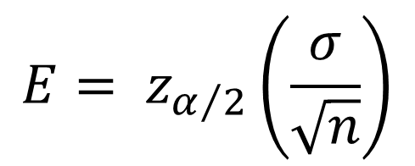
Using the margin of error to determine how big a sample size n should be
$${E= z}_{α/2}\left(\frac{σ}{\sqrt{n}}\right)$$
A scientist wishes to estimate the average depth of a river. He wants to be 99% confident that the estimate is accurate within 2 feet. From a previous study, the standard deviation of the depths measured was 4.33 feet.
Formula for the minimum sample size needed for an interval estimate of the population mean.
$$n={\left(\frac{z_{α/2}∙σ}{E}\right)}^{2}$$
$$n={\left(\frac{2.58∙4.33}{2}\right)}^{2}$$
$$n=31.2$$
When determining sample size, round up.
To be 99% confident that the estimate is within 2 feet of the true mean depth, the scientist needs a minimum of 32 measurement samples.

